Slide 1

Exploring Metropolitan Dynamics with an Agent-Based Model Calibrated using Social Network Data
Nick Malleson & Mark Birkin
School of Geography, University
http://www.geog.leeds.ac.uk/people/n.malleson
http://nickmalleson.co.uk/
Notes:
ABSTRACT
Exploring Metropolitan Dynamics with an Agent-Based Model Calibrated using Social Network Data
Nick Malleson and Mark Birkin
Model calibration and validation are two of the most contentious issues surrounding the use of agent-based models and, in these respects, models of social phenomena are lagging behind other fields. For example, agent-based models rarely use dynamic data streams to improve their predictions as new social data become available. Contrast this to meteorology where daily weather updates are constantly used to improve the model predictions.
Data availability has been largely responsible for these problems, but in recent years new data sources have become available that contain a wealth of information about people's spatio-temporal behaviour. These are often spatially referenced, individual-level, updated continuously and have the potential to revolutionise our understanding of social phenomena and our approach to model evaluation.
The original feature of this research is to develop a framework for calibrating an agent-based model of metropolitan dynamics using a novel set of crowd-sourced data from Twitter. In these early research stages we incorporate two general dynamic behaviours: 'at home' and 'away from home', but, as our paper will show, an advanced analysis of the data can provide a much greater level of detail about peoples' daily behaviours (such as 'working', 'shopping', 'education' etc.). Through this modelling process we seek not just to understand residential patterns within the city, but the dynamic ebb and flow of the population in everyday metropolitan life.

Slide 2
Outline
Research aim: develop a model of urban-dynamics, calibrated using novel crowd-sourced data.
Background:
Data for evaluating agent-based models
Crowd-sourced data
Data and study area: Twitter in Leeds
Establishing behaviour from tweets
Integrating with a model of urban dynamics

Slide 3
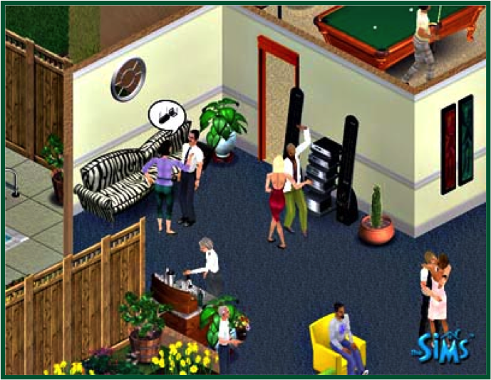
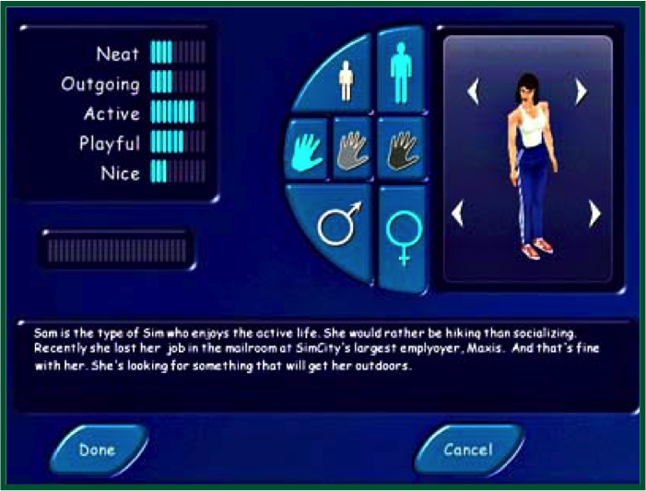
Agent-Based Modelling
Autonomous, interacting agents
Represent individuals or groups
Usually spatial
Model social phenomena from the ground-up
A natural way to describe systems
Ideal for social systems

Slide 4
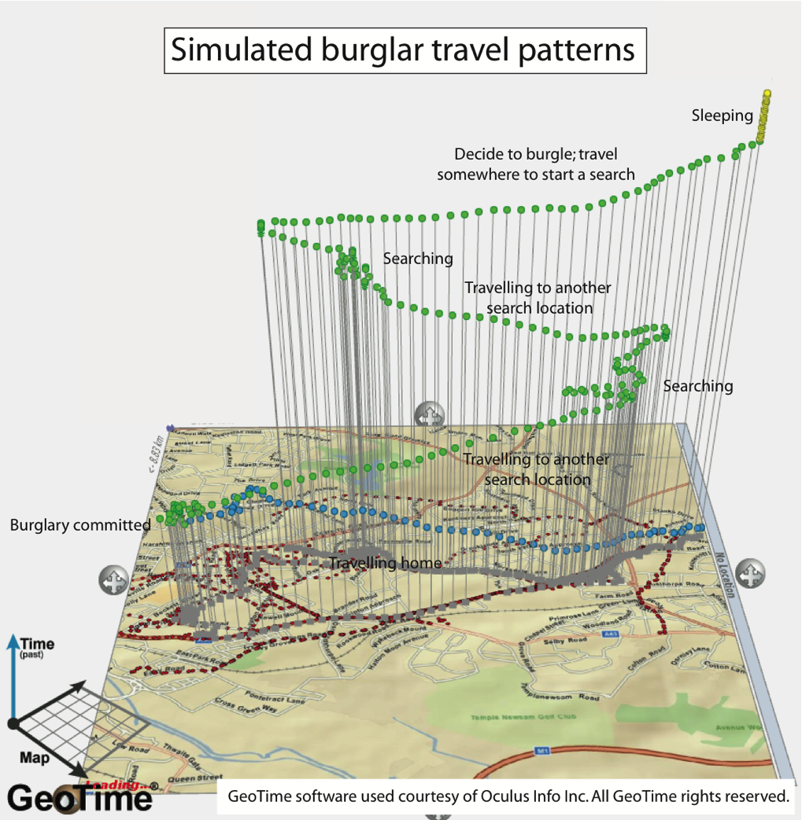
Advantages of ABM
More “natural” for social systems than statistical approaches
Dynamic history of system
Can include physical space / social processes in models of social systems
Designed at abstract level: easy to change scale
Bridge between verbal theories and mathematical models

Slide 5
Disadvantages of ABM
Single model run reveals a theorem, but no information about robustness
Computationally expensive
Sensitivity analysis and many runs required
Small errors can be replicated in many agents
“Methodological individualism”
Modelling “soft” human factors
Lack of individual-level data for evaluation

Slide 6
Data in Agent-Based Models
Data required at every stage:
Understanding the system
Calibrating the model
Validating the model
But high-quality data are hard to come by
Many sources are too sparse, low spatial/temporal resolution
Censuses focus on attributes rather than behaviour and occur infrequently

Slide 7
Crowd-Sourced Data for Social Science
“Crisis” in “empirical sociology” (Savage and Burrows, 2007)
Traditional surveys are small and occur infrequently
Often focus on population attributes rather than behaviour
Often spatially / demographically aggregated
http://www.guardian.co.uk/p/33p85
These are being superseded
“knowing capitalism”
Amazon.com purchasing suggestions / supermarket reward cards
“crowd-sourced” data / “volunteered geographical information”
E.g. OpenStreetMap, Flikr, Twitter, FourSquare, Facebook
Potentially very useful for agent-based models
Calibration / validation
Evaluating models in situ

Slide 8
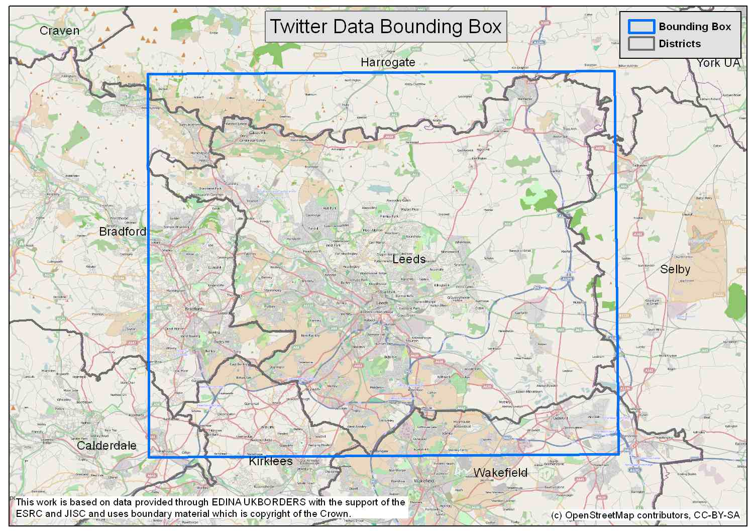
Data and Study Area
Twitter
Social networking / microblogging service
Users create public ‘tweets’ of up to 140 characters
For the most part, tweets are publicly available
Include information about user, time/date, location, text etc.
‘Streaming API’ provides real-time access to tweets
Collected Data
1.2M+ geo-located tweets around Leeds (June 2011 – March 2012).
403,922 Tweets within district
2,683 individual users
Highly Skewed (10% of all tweets from 8 most prolific users)
Filtered non-people

Slide 9
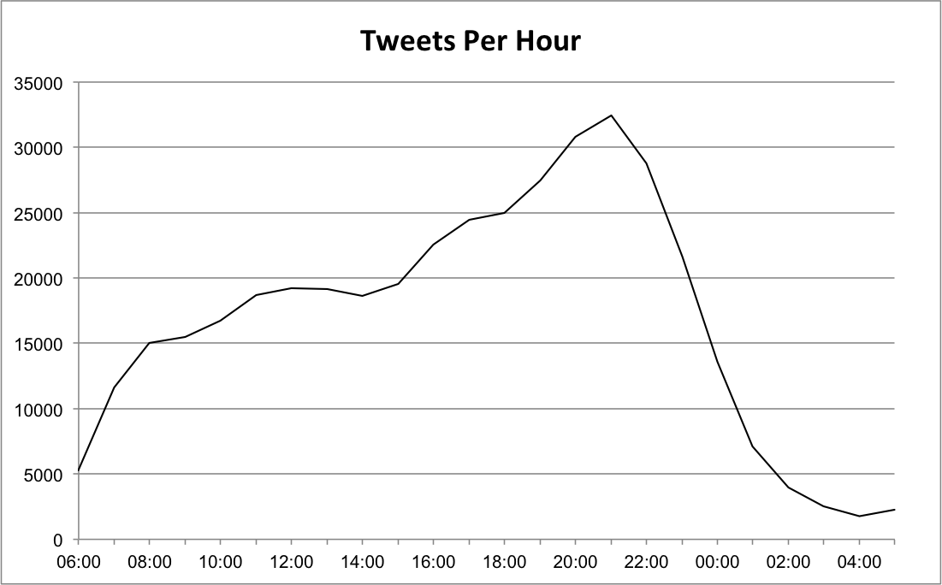
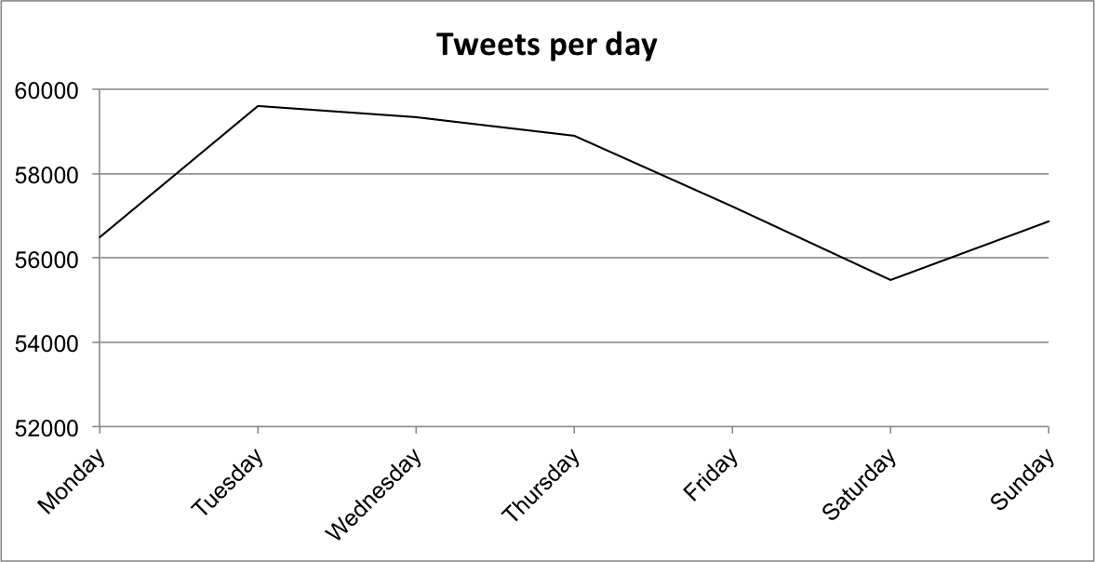
Temporal Trends
Hourly peak in activity at 10pm
Daily peak on Tuesday - Thursday
General increase in activity over time

Slide 10
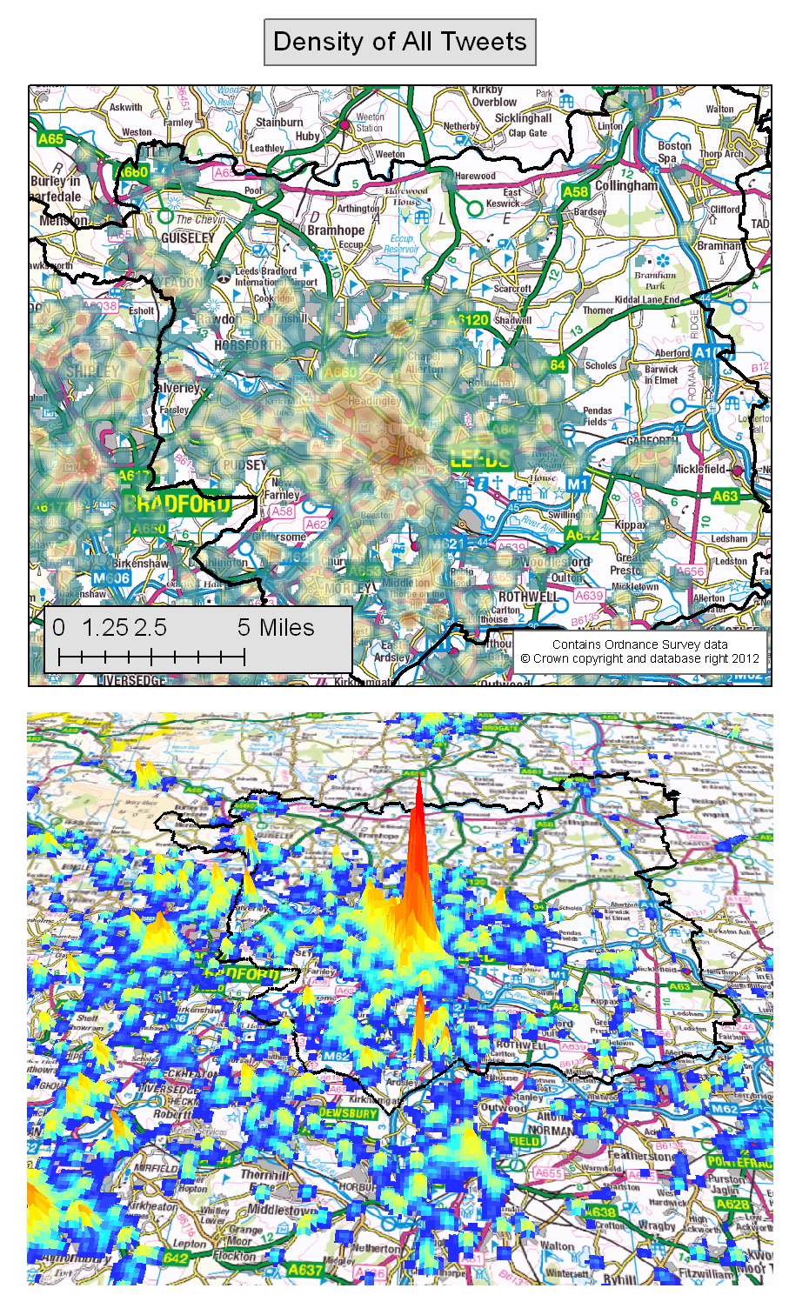
Spatial Overview
Point density appears to cluster around urban centres.
Also able to distinguish roads in non-urban areas
General pattern somewhat distorted by locations of prolific users

Slide 11
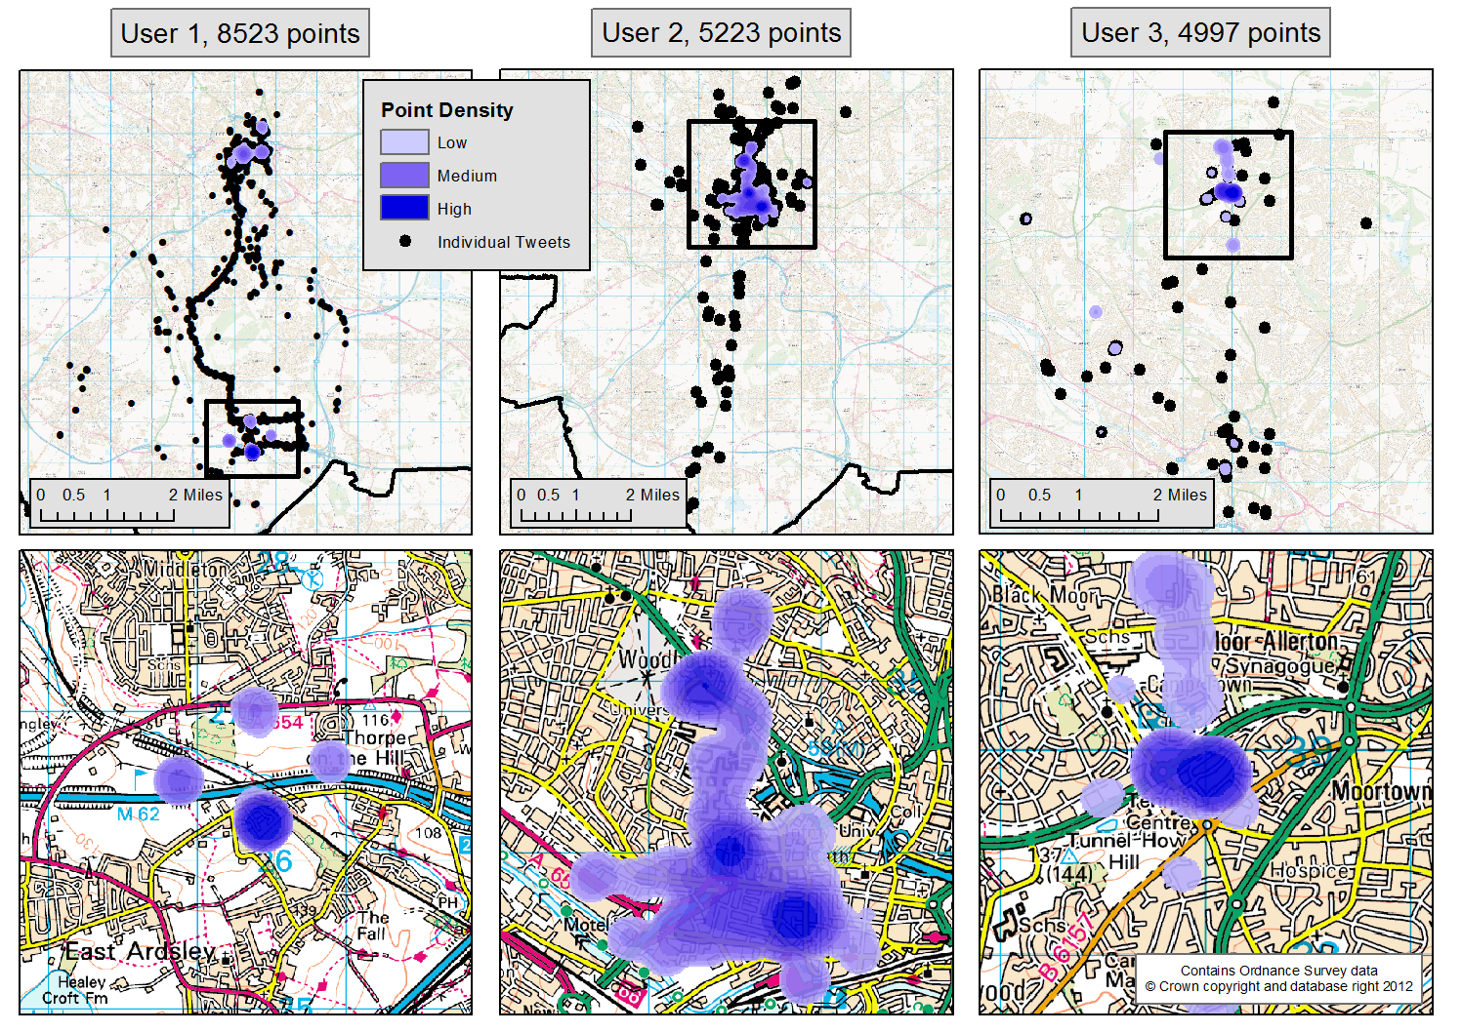
Analysis of Individual Behaviour – Anchor Points
Spatial analysis to identify the home locations of individual users
Some clear spatio-temporal behaviour (e.g. communting, socialising etc.).
Estimate ‘home’ and then calculate distance from home at different times
Journey to work?

Slide 12
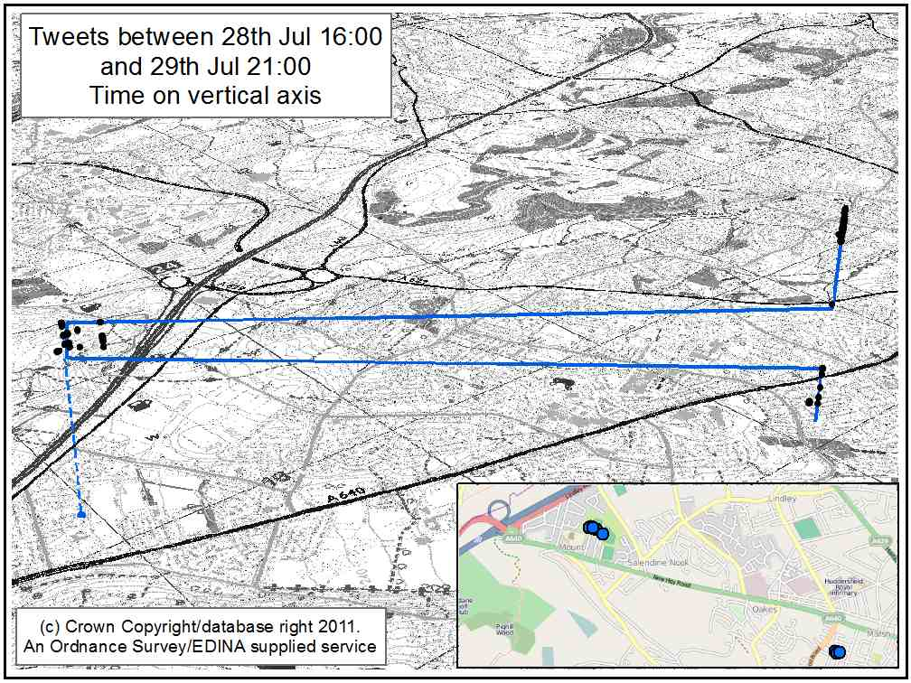
Spatio-Temporal Behaviour
More important than aggregate patterns, we can identify the behaviour of individual users
Estimate ‘home’ and then calculate distance at different times
Could estimate journey times, means of travel etc.
Very useful for calibration of an ABM

Slide 13
Activity Matrices (I)
Once the ‘home’ location has been estimated, it is possible to build a profile of each user’s daily activity
The most common behaviour at a given time period takes precedence
User | 0 | 1 | 2 | 3 | 4 | 5 | 6 | 7 | 8 | 9 | 10 | 11 | 12 | 13 | 14 | 15 | 16 | 17 | 18 | 19 | 20 | 21 | 22 | 23
a | 3 | 0 | 0 | 0 | 0 | 0 | 0 | 0 | 0 | 0 | 0 | 3 | 0 | 0 | 3 | 0 | 3 | 3 | 3 | 3 | 3 | 3 | 3 | 3
b | 3 | 3 | 0 | 0 | 0 | 3 | 3 | 0 | 0 | 0 | 1 | 3 | 1 | 0 | 3 | 0 | 0 | 3 | 3 | 0 | 1 | 3 | 0 | 0
c | 1 | 3 | 0 | 0 | 0 | 0 | 0 | 0 | 1 | 1 | 0 | 1 | 0 | 1 | 0 | 1 | 1 | 1 | 1 | 1 | 1 | 1 | 1 | 1
d | 0 | 0 | 0 | 0 | 0 | 0 | 0 | 0 | 0 | 1 | 0 | 0 | 3 | 0 | 3 | 1 | 1 | 1 | 1 | 1 | 1 | 1 | 1 | 1
e | 0 | 0 | 0 | 0 | 0 | 0 | 0 | 0 | 0 | 0 | 0 | 0 | 0 | 0 | 0 | 0 | 0 | 0 | 0 | 0 | 0 | 0 | 0 | 0
f | 1 | 0 | 0 | 0 | 0 | 3 | 3 | 3 | 3 | 3 | 3 | 3 | 3 | 3 | 3 | 3 | 3 | 1 | 3 | 3 | 3 | 1 | 1 | 1
g | 0 | 0 | 0 | 0 | 0 | 0 | 0 | 0 | 3 | 3 | 0 | 0 | 1 | 3 | 0 | 0 | 0 | 0 | 3 | 3 | 3 | 0 | 3 | 0
h | 0 | 0 | 0 | 0 | 0 | 0 | 0 | 3 | 3 | 0 | 0 | 0 | 3 | 0 | 0 | 0 | 0 | 0 | 0 | 0 | 0 | 0 | 0 | 0
i | 0 | 0 | 0 | 0 | 0 | 0 | 0 | 0 | 0 | 0 | 0 | 0 | 0 | 0 | 0 | 1 | 1 | 1 | 0 | 0 | 0 | 0 | 0 | 0
‘Raw’ behavioural profiles
Interpolating to remove no-data
At Home
Away from Home
No Data
User | 0 | 1 | 2 | 3 | 4 | 5 | 6 | 7 | 8 | 9 | 10 | 11 | 12 | 13 | 14 | 15 | 16 | 17 | 18 | 19 | 20 | 21 | 22 | 23
a | 3 | 3 | 3 | 3 | 3 | 3 | 3 | 3 | 3 | 3 | 3 | 3 | 3 | 3 | 3 | 3 | 3 | 3 | 3 | 3 | 3 | 3 | 3 | 3
b | 3 | 3 | 3 | 3 | 3 | 3 | 3 | 3 | 3 | 1 | 1 | 3 | 1 | 3 | 3 | 3 | 3 | 3 | 3 | 3 | 1 | 3 | 1 | 1
c | 1 | 3 | 3 | 3 | 3 | 1 | 1 | 1 | 1 | 1 | 1 | 1 | 1 | 1 | 1 | 1 | 1 | 1 | 1 | 1 | 1 | 1 | 1 | 1
d | 1 | 1 | 1 | 1 | 1 | 1 | 1 | 1 | 1 | 1 | 1 | 3 | 3 | 3 | 3 | 1 | 1 | 1 | 1 | 1 | 1 | 1 | 1 | 1
e | 1 | 1 | 1 | 1 | 1 | 1 | 1 | 3 | 3 | 3 | 3 | 3 | 3 | 3 | 3 | 3 | 3 | 3 | 1 | 1 | 1 | 1 | 1 | 1
f | 1 | 1 | 1 | 3 | 3 | 3 | 3 | 3 | 3 | 3 | 3 | 3 | 3 | 3 | 3 | 3 | 3 | 1 | 3 | 3 | 3 | 1 | 1 | 1
g | 3 | 3 | 3 | 3 | 3 | 3 | 3 | 3 | 3 | 3 | 3 | 1 | 1 | 3 | 3 | 3 | 3 | 3 | 3 | 3 | 3 | 3 | 3 | 3
h | 1 | 1 | 1 | 1 | 3 | 3 | 3 | 3 | 3 | 3 | 3 | 3 | 3 | 3 | 3 | 3 | 3 | 3 | 1 | 1 | 1 | 1 | 1 | 1
i | 1 | 1 | 1 | 1 | 1 | 1 | 1 | 3 | 3 | 3 | 3 | 3 | 3 | 3 | 3 | 1 | 1 | 1 | 1 | 1 | 1 | 1 | 1 | 1

Slide 14
Activity Matrices (II)
Overall, activity matrices appear reasonably realistic
Peak in away from home at ~2pm
Peak in at home activity at ~10pm.
Next stages:
Develop a more intelligent interpolation algorithm (borrow from GIS?)
Spatio-temporal text mining routines to use textual content to improve behaviour classification

Slide 15
Towards A Model of Urban Dynamics – Design
Use microsimulation to synthesise an initial population (all residents in a city)
Estimate where people go to work
Estimate when people go to work and how long they spend there (initial model parameters)
Calibrate these parameters to data from Twitter (e.g. ‘activity matrices’) using a genetic algorithm

Slide 16
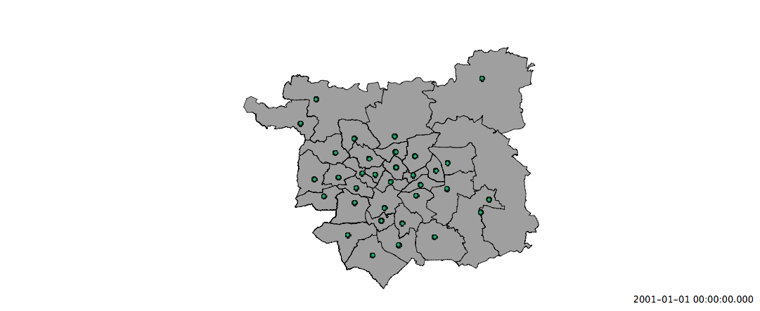

Prototype Model

Slide 17
Conclusions & Future Work
New “crowd-sourced” data can help to improve social models
Improved identification of behviour
“Spatio-temporal text mining”
Methods to classify text based on spatio-temporal location as well as textual content
In situ model calibration

Slide 18
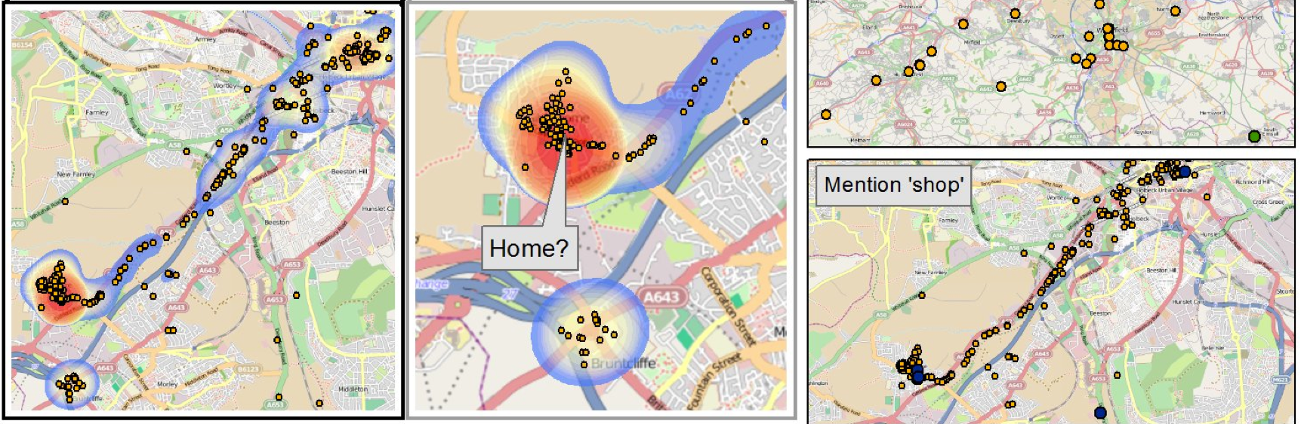
Thank you
Nick Malleson, School of Geography, University of Leeds
http://www.geog.leeds.ac.uk/people/n.malleson
http://nickmalleson.co.uk/

